Slide 1


Digital Assistant for Students
Agile Business Analysis
Anton, Lorenzo, Luca, Marc

Slide 2



Needs
Administration
→Interview
Avoid answer repetitively the same
Reduce amount of requests
Ability to answer fast and consistent
Students
→Survey
Fast answers
Correct answers
Consistent answers
Head of Program →weekly feedback
Reduction of effort
Supporting solution for students and admin
Solution with high usability
Neyyer
Knut

Slide 3
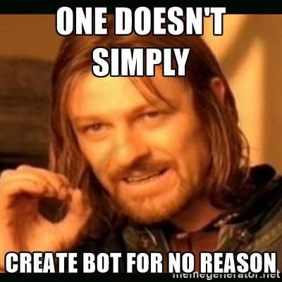
Approach -> Digital Assistant
Strong stakeholder involvement:
Interview, surveys, weeklies
Iterative PoC development (Dialogflow & Integromat):
Static responses: Links, Docs (Dialogflow)
Dynamic responses: Info taken from Google Sheet (Integromat)
Dynamic responses: Info also saved to Google Sheet (Integromat)
Notes:
Marc
To ensure that needs are covered -> strong stakeholder involvement
Surveys: 1) for gathering general needs, 2) for in depth analysis how you would ask for certain information
Dev. of Proof of Concept, iterative adjustments according sponsor wishes
1. Step Static Responses (Dialogflow only)
2. Step Dynamic Resp. (Dialogflow, Webhook/Integromat, Google Sheet read only)
3. Step Dynamic Resp. (Dialogflow, Webhook, Google Sheet read & write)

Slide 4
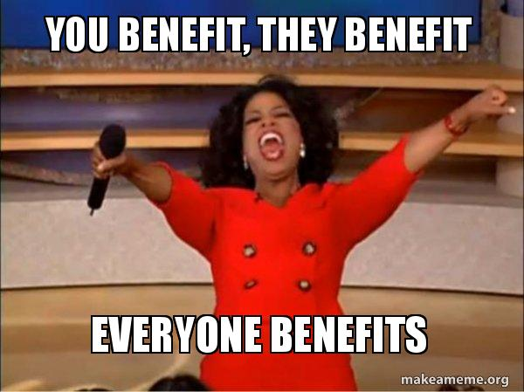
Benefit
Administration
→ Automation of routine tasks / conversations
Students
Increased availability and accessibility
of information
Functionalities
Module registration / deregistration
Exam dates
Exam results (grades)
Module information (descriptions)
Dates

Slide 5
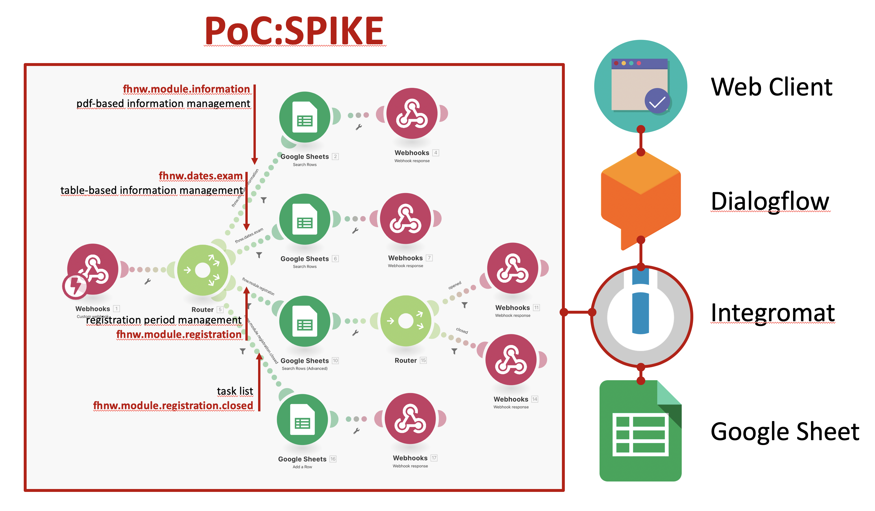

Slide 6
Live demo
Notes:
Anton

Slide 7
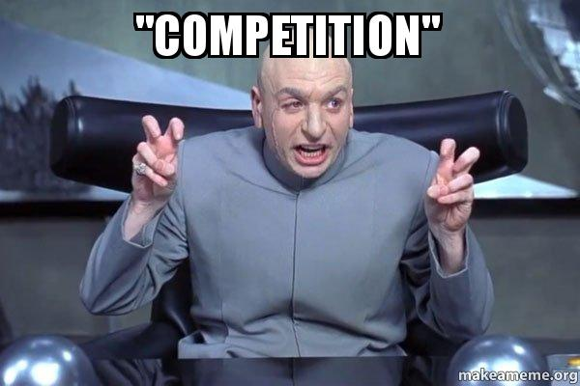
The Alternative (Competition)
E-Mail exchange (status quo) →much longer response time →Recurring answering of the same questions →Responses less consistent
Slower and less consistent
=lower satisfaction for all stakeholders
Notes:
Luca

Slide 8
Whats next?
Proof of concept → Implementation
Extension of features
Needed: Sponsor for budget
→Keep going with the support for students to further develop the digital assistant for FHNW
Notes:
Luca

